Slide 1
Python Loops

Slide 2

Loops are used in programming to repeat a
specific block of code.
It offer a quick and easy way to do something repeated until a certain condition is reached.
Python supports following loops
While loop
For loop
Python does not have do-while loop.

Slide 3
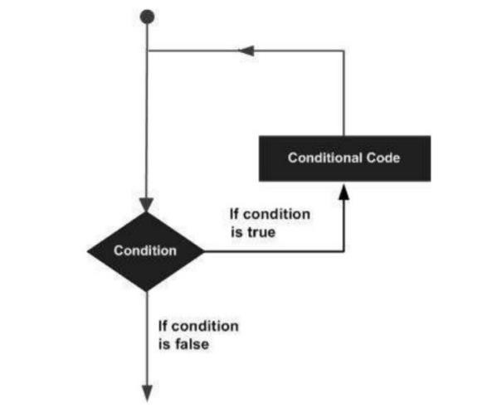


Slide 4
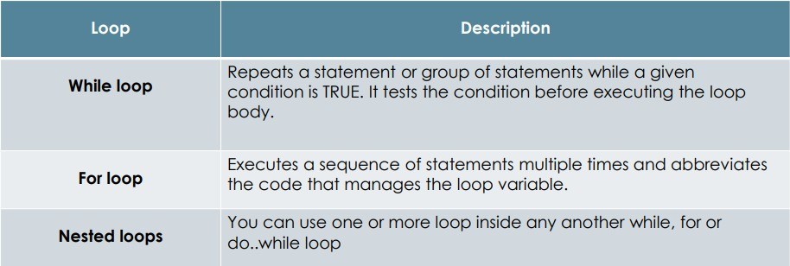
Python programming language provides following types of loops to handle looping requirements.

Slide 5
1 The while Loop

Slide 6
While loop is a control flow statement that allows code to be executed repeatedly based on a given Boolean condition.
It consists of condition/expression and a block of code.
The condition/expression is evaluated, and if the condition/expression is true, the code within the block is executed.
This repeats until the condition/expression becomes false.

Slide 7
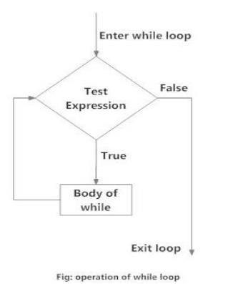
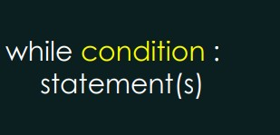
Syntax
Flow Chart

Slide 8

Example 01:
Print the first 10 natural numbers using while loop.

Slide 9
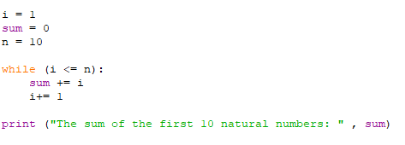
Example 02:
Print the sum of the first 10 natural numbers using a while loop.

Slide 10
Task 01

Slide 11



Write python codes to get the following outputs.
“

Slide 12
“
Print multiplication table of 12.

Slide 13
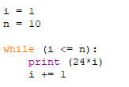

Slide 14
Take 10 integers from keyboard using loop and print their average value on the screen.
“

Slide 15

Print the following pattern.
“

Slide 16
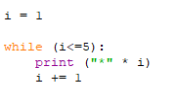

Slide 17
Print even numbers from 0-25 using a while loop.
“

Slide 18
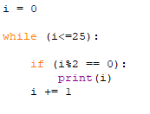
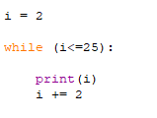

Slide 19
Find the factorial of a number entered by the user
“
Eg: If the number is 5 the factorial should be 120 1*2*3*4*5 =120

Slide 20

Try to write the code snippet for the below pattern.
“
27

Slide 21

Thanks!
ANY QUESTIONS?
28

